Slide 1

Adidas US Sales Performance Analysis
Transforming Raw Data into Actionable Dashboard Insights
Project Goal
To transform raw, messy sales data into a clean, structured, and fast-to-query database, culminating in interactive dashboards to reveal key performance and profit trends.
Prepared by Insight Queens
Amina Emam
Habiba Yasser
Noha Amr
Jodie Abdelrahman
Engy Mohamed
Manar Mohamed

Slide 2

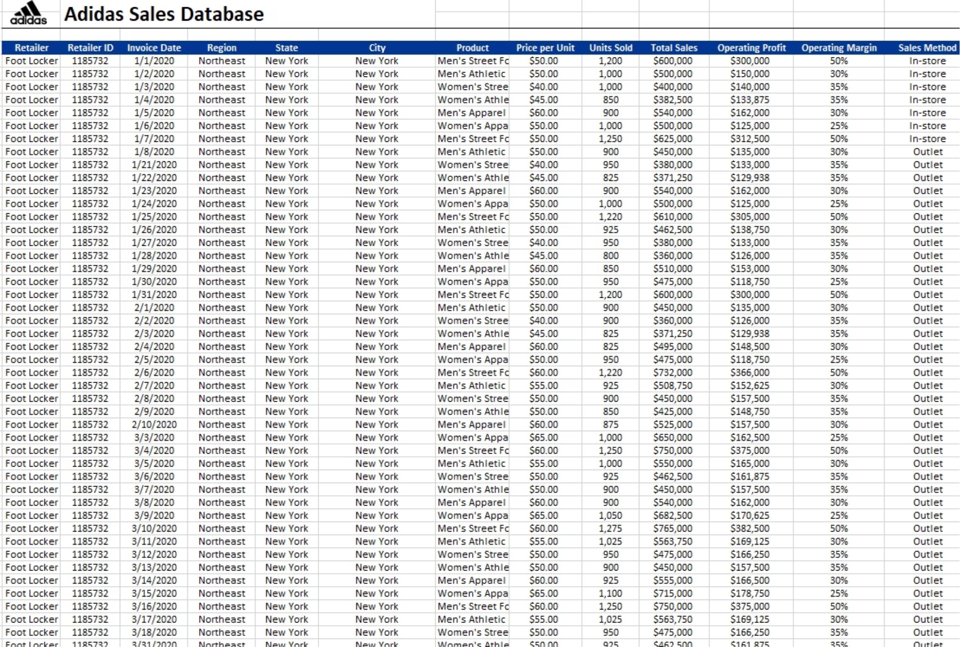
Dataset Overview
Raw Data
Source: Kaggle (Adidas US Sales Dataset)
Adidas Sales Dataset
Focus: Sales by Region, Product, Retailer, and Sales Method
Market Research report :
Adidas_Sales_Report.pdf
Tools Used
Python (Pandas): Data Cleaning and Preparation
SQL (Database): Dimensional Design (ERD) and Implementation (ETL)
Power BI: Visualization and Insight Generation

Slide 3
Our End-to-End Analytics Pipeline
Converting raw information into clean, usable data for strategic decision-making.
01
02
03
Data Acquisition & Cleaning (python)
Data Modeling (ERD) & Staging
ETL (SQL Transformation)
we designed the "ideal" database structure as a Star Schema (ERD) for future scalability. For this project's scope, we loaded the data into a single 'staging table' (adidasus) to centralize it.
Implemented in-place 'Transform' processes on the staging table. Critically, we transformed text-based dates into a proper DATE format using STR_TO_DATE
Utilized Python to remove special characters (e.g., '$'), standardize text , and prepare the raw data for SQL loading
04
05
KPI Calculation (SQL)
Visualization & Insights (Power BI)
Executed complex SQL queries against the staging table to compute critical business metrics: Total Revenue, Operating Profit, Sales by Region and Monthly Trends.
Built dynamic Power BI dashboards to translate complex data into clear, interactive visual stories for key stakeholders.

Slide 4

Data Quality: Cleaning with Python (Pandas)
Addressing inconsistencies and ensuring data integrity is the crucial first step for reliable analysis.
The "Why": Addressing Data Inconsistencies
Python's Role: Precision Cleaning
Preparing for Transformation
Raw data often contains formatting errors, such as currency symbols ('$') within numeric fields and inconsistent date formats, which hinder proper analysis. Cleaning ensures accurate calculations and consistent reporting.
Pandas was leveraged for its powerful data manipulation capabilities. Specifically, we targeted the 'Total Sales' and 'Operating Profit' columns, removing non-numeric characters and converting them to float data types.
The 'Invoice Date' column, with its non-standard format, was intentionally left as text. This "stages" the problem for SQL to solve in the next step of our pipeline.
import pandas as pd# Load the datasetdf = pd.read_csv('adidas_us_sales.csv')# Remove '$' and ',' from currency columns and convert to numeric# This is a more robust way to clean both characters at once.df['Total Sales'] = df['Total Sales'].replace('[\$,]', '', regex=True).astype(float)df['Operating Profit'] = df['Operating Profit'].replace('[\$,]', '', regex=True).astype(float)# --- We intentionally DO NOT convert the 'Invoice Date' here ---# This problem will be solved in SQL (Step 3).# Display the head of the cleaned numeric columnsprint(df[['Total Sales', 'Operating Profit']].head())
Google colab link:

Slide 5
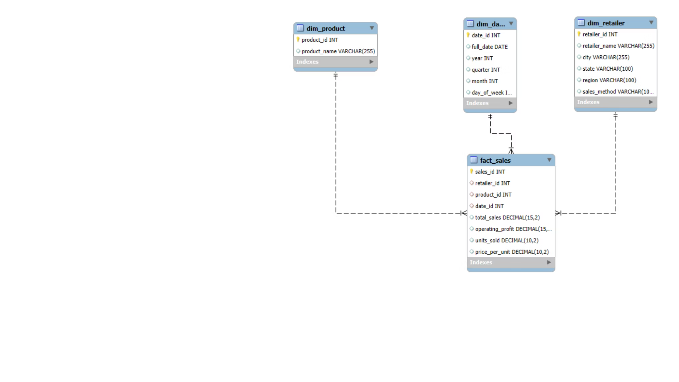


The Foundation:
Dimensional Modeling (ERD)
This ERD represents our "ideal" design. The following slides show our "implementation" on a single staging table.
Star Schema Principles
This model separates transactional data (metrics like sales amounts) from descriptive attributes (details about products, retailers, and dates). This design simplifies queries and enhances performance.
Central Fact_Sales Table
Contains the quantitative measures (e.g., Total Sales, Operating Profit, Units Sold) and foreign keys linking to the dimension tables. It is where the 'numbers' live.
Dim_Retailer
Dim_Product
Dim_Date
Stores descriptive data about each retailer, such as retailer name and ID.
Holds details about each product, including its unique ID and product name, as shown in the ERD
Provides temporal details such as year, quarter, month, and day for time-based analysis.

Slide 6

The "T" in ETL: SQL Transformation (The "Hero" Step)
This is our "implementation" step. We performed the critical data transformations directly on our staging table (adidasus).
The most critical transformation was fixing the "date" problem, which Python could not solve , We used SQL to convert the "text date" into a "real date" format.
-- 1. Add a new, empty column with the correct 'DATE' datatypeALTER TABLE adidasusADD COLUMN invoice_date_clean DATE;---- 2. Populate this new column by 'reading' the old textSET SQL_SAFE_UPDATES = 0;UPDATE adidasusSET invoice_date_clean = STR_TO_DATE(invoice_date, '%c/%e/%Y')WHERE invoice_date IS NOT NULL AND invoice_date != '';
KPI Calculation (The "Payoff")
With our data transformed (especially the dates), we could finally execute our analytical queries
These queries were impossible before our transformation. Now, we can calculate monthly trends and regional sales directly from our clean staging table .
-- Example 1: Monthly Sales Trend (Now Possible!)SELECT DATE_FORMAT(invoice_date_clean, '%Y-%m') AS sales_month, SUM(CAST(REPLACE(total_sales, '$', '') AS DECIMAL(10, 2))) AS monthly_salesFROM adidasusWHERE invoice_date_clean IS NOT NULLGROUP BY sales_monthORDER BY sales_month;-- Example 2: Sales by RegionSELECT region, SUM(CAST(REPLACE(total_sales, '$', '') AS DECIMAL(10, 2))) AS total_sales_by_regionFROM adidasusGROUP BY regionORDER BY total_sales_by_region DESC;

Slide 7
Measuring Success: Key Performance Indicators (KPIs)
Our KPIs are strategically chosen to provide a clear view of business health and operational effectiveness.
1
2
Total Sales Revenue
Operating Profit
Business Goal: To track the overall financial scale and growth of Adidas US sales over time.
Business Goal: To assess the profitability of core operations before interest and taxes.
SELECT SUM(CAST(REPLACE(total_sales, '$', '') AS DECIMAL(10, 2))) AS TotalRevenueFROM adidasus;
SELECT SUM(CAST(REPLACE(operating_profit, '$', '') AS DECIMAL(10, 2))) AS TotalOperatingProfitFROM adidasus;
3
4
Sales by Region
Monthly Sales Trend
Business Goal: To identify geographical strongholds and areas for potential market expansion or concern.
Business Goal: To understand seasonal patterns, identify growth trends, and forecast future performance.
SELECT region, SUM(CAST(REPLACE(total_sales, '$', '') AS DECIMAL(10, 2))) AS SalesByRegionFROM adidasusGROUP BY regionORDER BY SalesByRegion DESC;
SELECT DATE_FORMAT(invoice_date_clean, '%Y-%m') AS sales_month, SUM(CAST(REPLACE(total_sales, '$', '') AS DECIMAL(10, 2))) AS MonthlySalesFROM adidasusWHERE invoice_date_clean IS NOT NULLGROUP BY sales_monthORDER BY sales_month;;

Slide 8
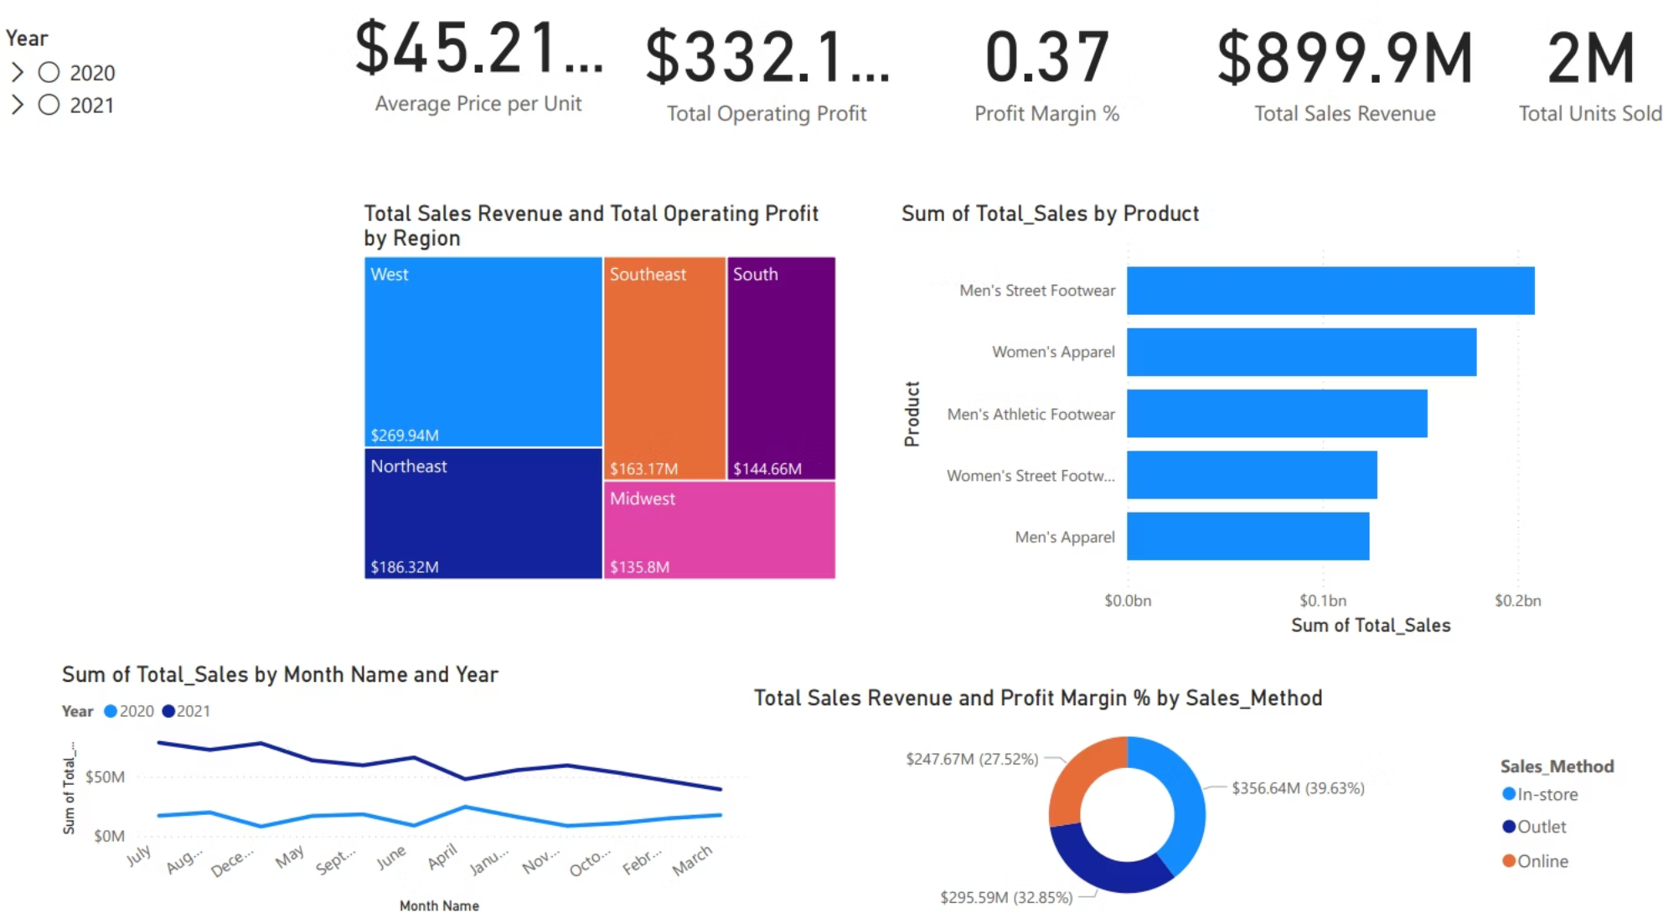
Storytelling with Data: Power BI Dashboards
1. Executive Dashboard
Key Findings
Purpose: Performance Overview (2020-2021) that provides a comprehensive, real-time overview of the Adidas US sales.
Top Product: Men's Street Footwear generated the highest total sales revenue.
Sales Channel: Online is the leading sales method, contributing the highest Total Sales Revenue at $356.64M and the highest Profit Margin at 39.63%.
Yearly Comparison: Total sales in 2021 consistently exceeded those in 2020 every month.
Top Region: The West region contributed the highest Total Sales Revenue at $269.94M.

Slide 9
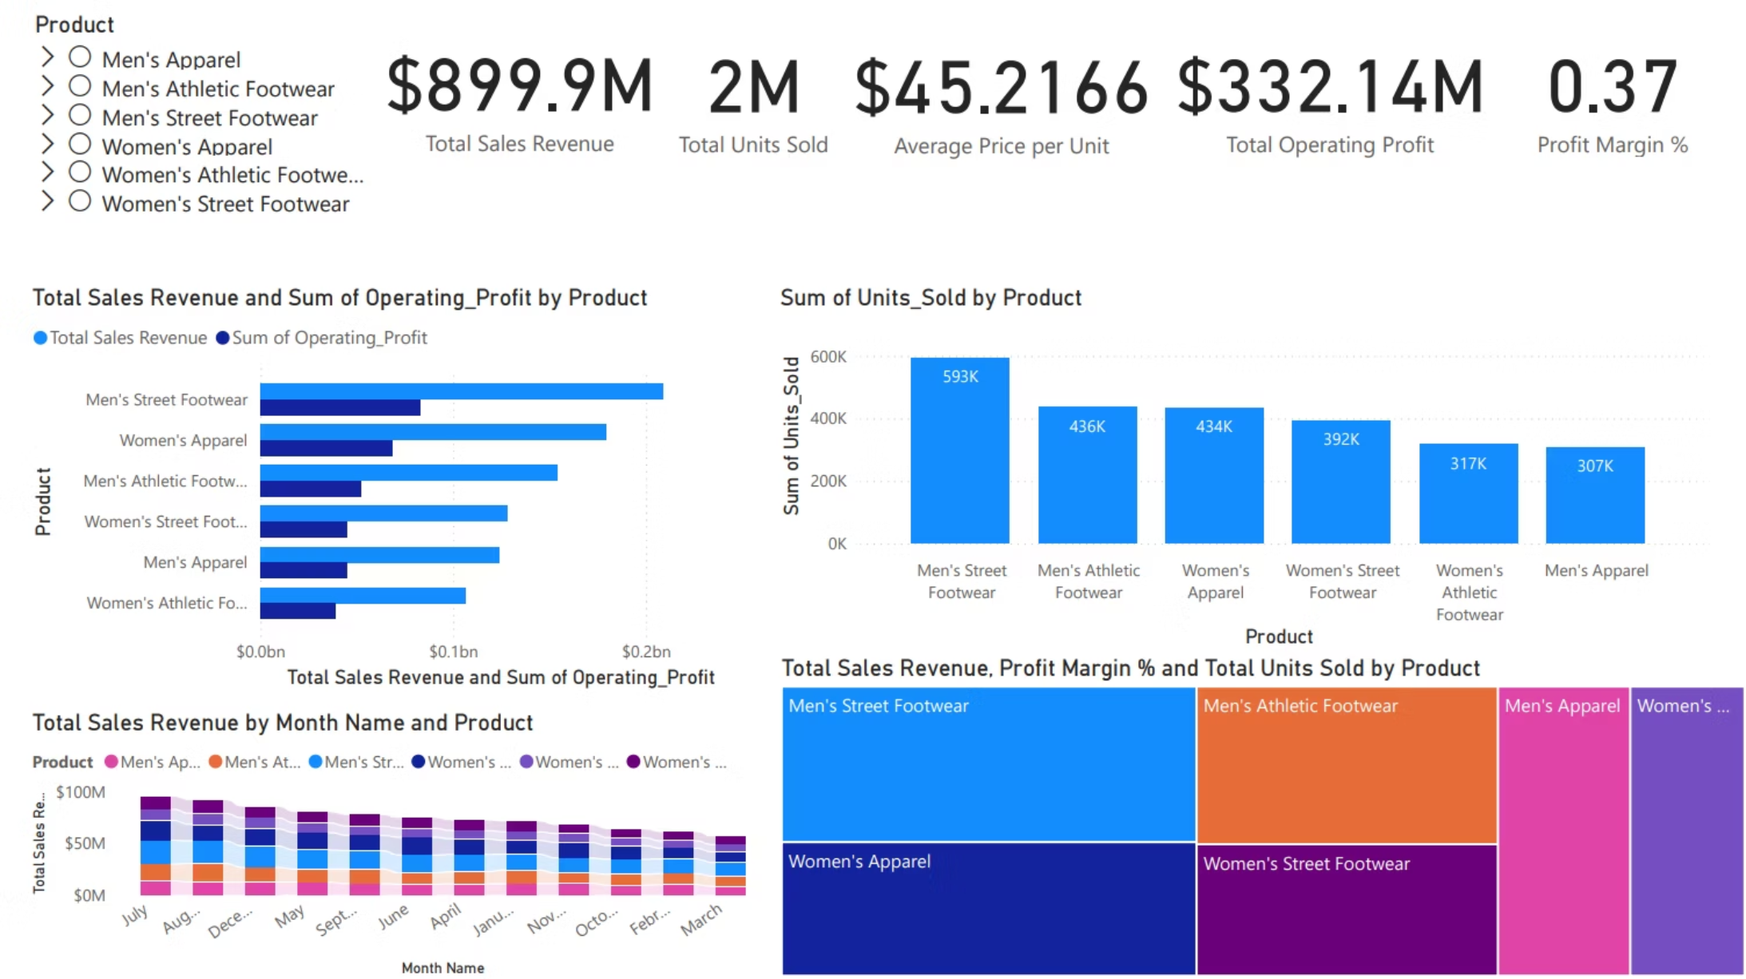
2. Product Performance Dashboard
This dashboard isolates our sales data by Product Category (e.g., Footwear, Apparel). It allows the team to compare the financial performance of each product line, tracking which categories contribute most to Total Sales and Operating Profit.
Key Findings
Units Sold Leader: Men's Street Footwear sold the highest volume of units at 593K.
Product Profit: Men's Street Footwear also generated the highest Total Sales Revenue and Sum of Operating Profit.
Monthly Revenue Peak: Total Sales Revenue across all products was highest in July

Slide 10
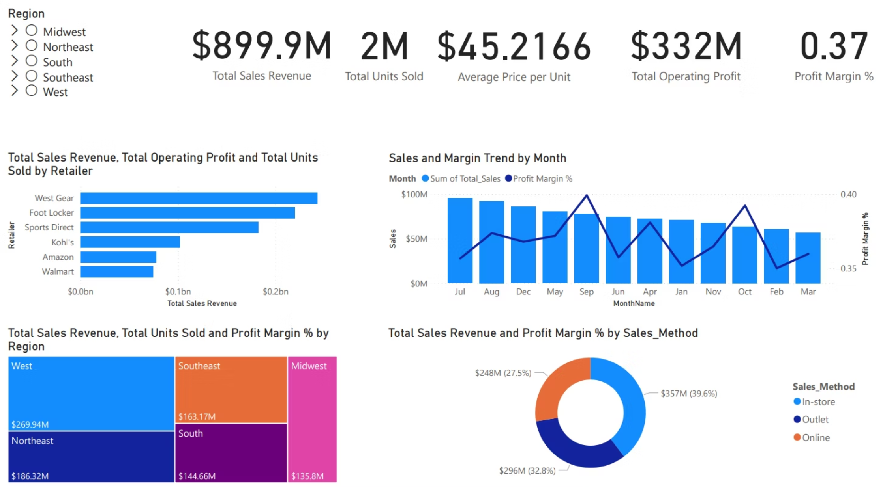
3. Retailer & Regional Dashboard
This dashboard provides a competitive view of the business, isolating performance by Retailer (e.g., Foot Locker, Walmart) and US Region (e.g., Northeast, Midwest). It tracks which partners and locations are driving the highest Total Sales and Operating Profit to support optimized allocation and resource planning.
Key Findings
Top Retailer: West Gear and Foot Locker are the top retailers by Total Sales Revenue.
Monthly Highs: Sales (Sum of Total Sales) were highest in July and Profit Margin % peaked in September.
Monthly Lows: Both Sales and Profit Margin % reached their lowest points in March.

Slide 11
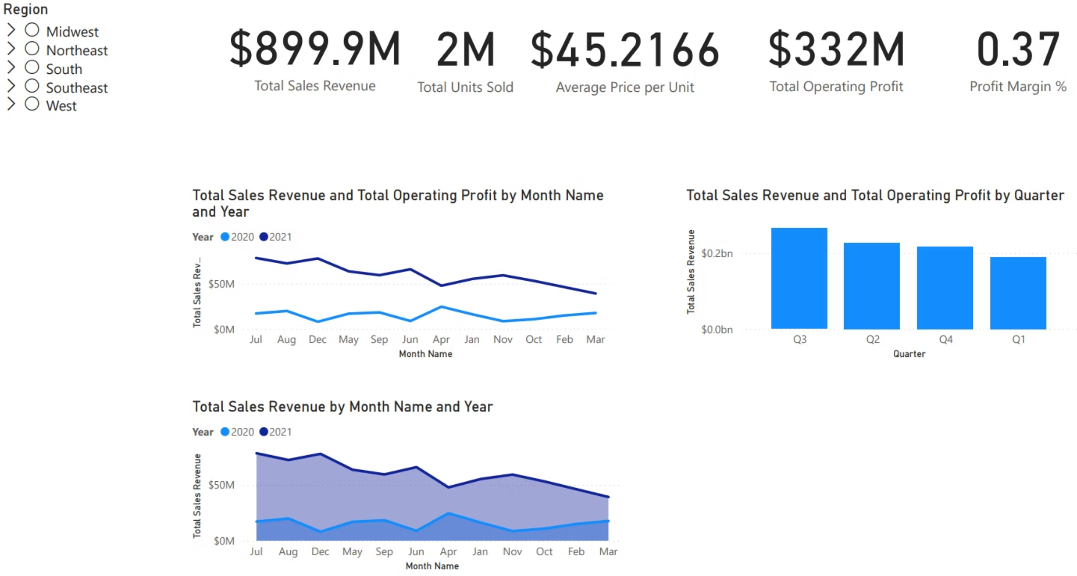
4. Time Series & Trend Dashboard
This dashboard uses line charts to illustrate sales seasonality and performance trends over the 2020–2021 period. It is designed to quickly identify Peak Sales Months, compare performance Year-over-Year (2021 vs. 2020), and track the overall Momentum (upward or downward) of Total Sales and Operating Profit across time.
Key Findings
Quarterly Performance: Q3 recorded the highest Total Sales Revenue, followed by Q2, Q4, and then Q1.
Annual Trend Confirmation: The chart confirms that Total Sales Revenue in 2021 was substantially higher than in 2020 throughout the year.

Slide 12


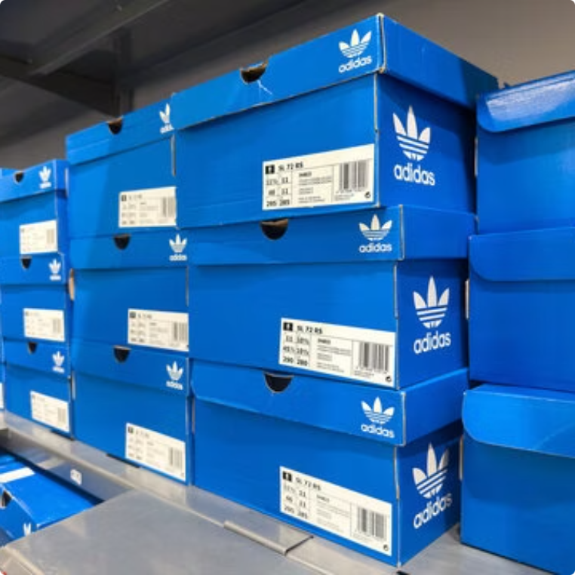

Top Takeawys
Men's Street Footwear generates the highest Total Sales Revenue.
Sales in 2021 are consistently and significantly higher than sales in 2020 across all months.
Men's Street Footwear sold the most units at 593K.
Online is the highest revenue and highest profitability channel with $357M in sales and a 39.6% Profit Margin.
These interactive dashboards allow stakeholders to drill down into specific data points, empowering data-driven decisions at every level.

Slide 13

Conclusion & Strategic Recommendations
Leveraging dashboard data to drive actionable business strategies for the upcoming years.
Project Summary
We have analyzed the complete 2020-2021 US sales data, revealing key performance indicators including product leaders, channel efficiency, and time-based sales cycles, providing a strong foundation for strategic decision-making.
Channel & Margin Optimization
Regional Focus & Product Reinforcement
Stabilize Seasonal Weakness
Prioritize investment in the Online channel (Highest Revenue: $357M, Highest Margin: 39.6%). Immediately review the low profitability of the In-store channel (Lowest Margin: 27.5%).
Implement aggressive campaigns in Q1 and March to mitigate the period of lowest sales and profit margin, ensuring a stable performance following the Q3 revenue peak.
Maximize sales efforts in the top-revenue West region ($269.94M). Develop a remediation plan for the low-revenue Midwest ($135.8M). Continue to anchor the product strategy around the market leader, Men's Street Footwear (593K Units Sold).
Future Recommendations
Integrate cost data to calculate true Net Profit.
Study the successful pricing strategies of West Gear and Foot Locker for replication.

